Slide 1
Prediction of soil fertility and crop productivity through machine learning algorithms
Group 5
Dr. Md. Khairul Alam
Dr. Mohammad Mukhlesur Rahman
Mustafa Kamal Shahadat
Arindam Biswas

Slide 2
Justification
Crop productivity is a function of many factors. Among them soil fertility, physiography, crop management, weather parameters etc. are major factors. However, these factors are highly variable both spatially and temporally. A number of machine learning algorithms have been evaluated by many scientists for predicting soil fertility and crop production. The present study focuses on evaluation on various supervised and unsupervised machine learning techniques for predicting soil fertility and crop production.
Objectives:
Prediction of soil fertility status according to agroecological zone.
Prediction of crop production scenario based upon environmental features.

Slide 3
Methodology
Step 1: Source of data and about dataset
2 datasets-
Historical crop production and weather data
495 samples of soil test data collected from the farmers field from various locations. Each data point is spatially referenced. So far the dataset contains 15 features.
Step 2: Data pre-processing and exploratory data analysis
Missing values will be corrected through either dropping or suitable imputation method. Necessary data transformation, encoding (level or one-hot encoding), summary, correlation matrix, visualization, features selection etc. steps will be followed.
Finally, the dataset will be spilted into training and test set, where training set will cover 80% of the data and 20% will be used for testing.
Step 3: Model selection and algorithm setting
Both supervised machine learning classification will be followed. Such as regression, logistic regression, DTs, SVM, RF, CART, ANN etc. For model tuning necessary hyperparameters will be optimized through grid search.
Step 4: Evaluation of the model: model score, confusion matrix

Slide 4
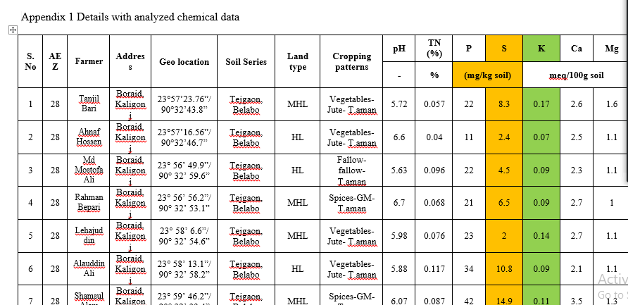
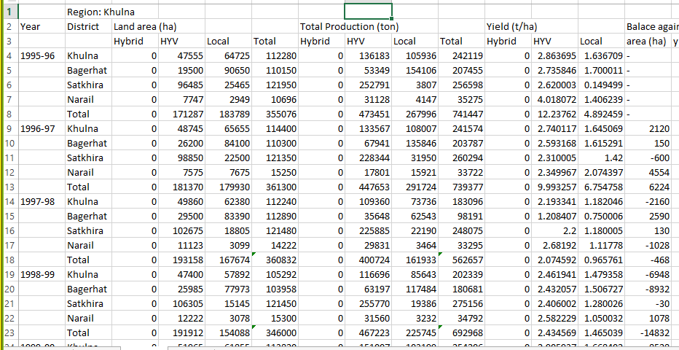
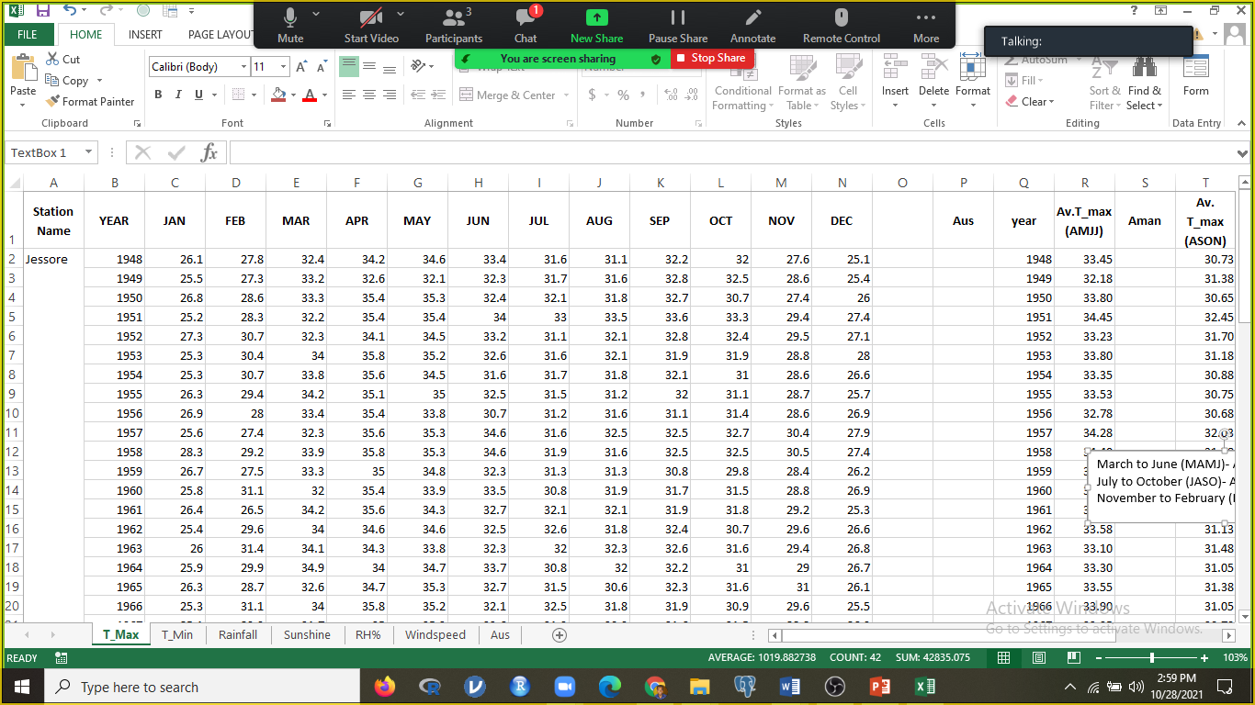

Slide 5
Future study
Expected output
Crop yield and production prediction.
Soil fertility class
Soil salinity and fertility mapping.
Preparation of crop suitability map based upon soil fertility and remote sensing data.

Slide 6
Model
MR
RF
Training
Crop Prediction
DT
Data set
Crop
Climate
SVM
Data preprocessing
GB
Test set
Check the model

